Slide 1
nexTurn is a global technology services firm specialized in providing end-to-end cloud services. We help clients accelerate their innovation & digital transformation journey by unlocking full value of cloud.

Slide 2
Solution Diagram
Monitoring
Mobile
Microservice
API
GATEWAY
Service
HTTP
Tab
Service
Service
Desktop
ELK logs
Zipkin Tracing

Slide 3
Face Detection Process
Android App:
Capture Image/Select Image from Gallery
Check required access
Choose option to select image
Selected image upload to server using retrofit ( Async HTTP call)
Display the response
Spring Boot REST API:
Receive the image from client and save it in local directory
Load opencv library
Load haar cascade model
Detect faces from image
Return the response

Slide 4
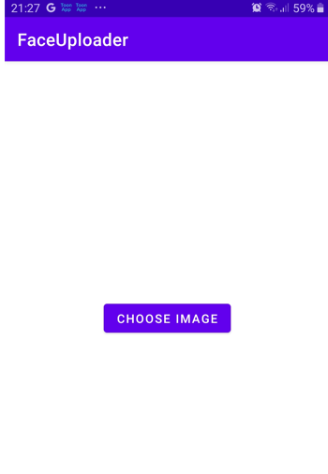
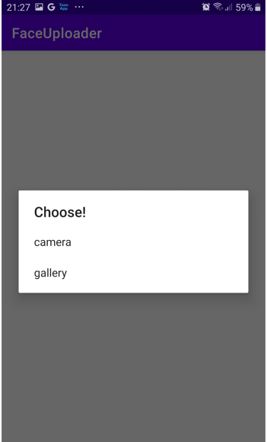
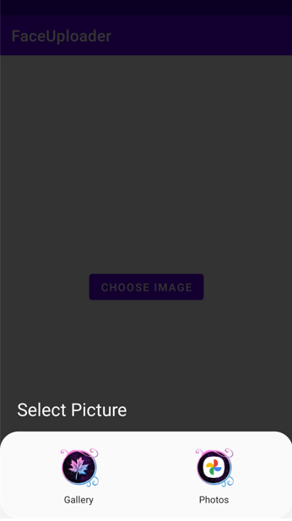

Slide 5
Open Issues
Facing issue while uploading the image and work is in progress

